Slide 1
WP4. Implementation of developed master curricula and trainings
Zakhar Maletskyi & Harsha Ratnaweera
planning meeting 15 September 2020
follow up of the kick-off meeting, December 2018
This project has been funded with support from the European Commission. This publication reflects the views only of the author, and the Commission cannot be held responsible for any use which may be made of the information contained therein

Slide 2
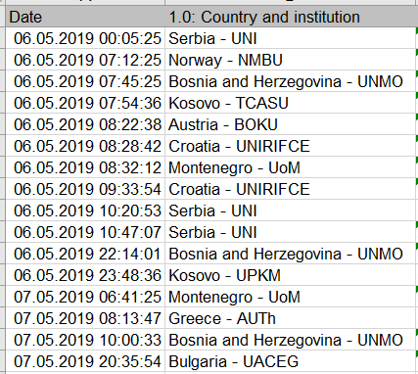
Preparation
Early planning:
Workshop at the kick-off
Online survey
+ lockdown limitations
Updated plan

Slide 3
What have we promised in the application?

Slide 4
WP4 Inputs & Outputs
Catalogue of competences
6 trainings
90 WB teaching staff members trained
Oct-Nov 2020
Curricula implementation
Trainings for professionals
7 x 3-days trainings
210 professionals
One self-evaluation report per training
SWARM set of courses
WP 4
Materials for trainings
← Third project year →
10-15 students per WB univ enrolled
One self-evaluation report per term – twice a year
Accreditation of curricula
Students enrolled and interested
Dec-20/Jan-21
Self evaluations
of curricula and trainings
Equipped laboratories
Professionals are interested
15 Oct 2021

Slide 5
Activities
Implementation of developed Master Curricula
by Oct 2021
2nd Cycle Degree
EQF Level 7
60 or 120 ECTS
Training of participants
10-15 students per WB Uni
Intensive courses during winter/summer schools at EU partner Uni
One webinar
for 3 days
each Wb uni
involves 30 participants
Trainings for professionals
1
2
3
4
5
6
Self-evaluation
2 Quality Reports
7
3-day trainings
30 participants per training
In Western Balkan Universities
210 professionals
by Jan 2021

Slide 6
Curricula Implementation

Slide 7
Curricula implementation
A4.1 Implementation of developed master curricula New 10-15 master students will be enrolled at each WB partner HEI starting from October 2020. They will be trained how to use new and up-to-date laboratory equipment and software which can be directly applied in water sector
A4.3 Self-evaluation of master curricula The self-evaluation will be done twice a year (in winter and in summer semesters). The quality of teaching, including teachers’ methodological approach, availability of literature and laboratory equipment will be performed.
Survey
Poll

Slide 8
Upgrade of curricula
How can we document upgrade of existing Master curricula?
New accreditation body in Serbia – procedure is not clear yet
Existing program – upgraded study plans / syllabus
…
How UNI and TCASU will document development of completely new study programs based on implemented courses
Accreditation of new programs in National System (?) - licenses

Slide 9
Formalisation of curricula upgrades – we will send a survey
University | Measures / documents
UoNiš | In process: Submitted docs for accreditation of Bsc/Msc – expected by the end of 2020
UoNoviSad | Done: approvement on the courses, accreditation of the national body
UoSarajevo | Done: faculty council approved subject updates
UoMostar | Done: faculty council approved subject updates
UoPriština | Done: faculty council approved subject updates
CollUrosevac | New study program submitted to the national accreditation body – expected by the end of 2020
UoMontenegro | Done: faculty council approved subject updates

Slide 10
Enrolled students – we will send a survey
University | Rough estimation / formal proof / status of studies
UoNiš | 15 students at BSc – June 2021 / 5-10 MSc end of 2020 / locked until accreditation / 50:50
UoNoviSad | 4-5 MSc/year – enrolment in process by end of October 2020 / online, not clear how
UoSarajevo | 15 MSc – enrolment by end of 2020 / 50:50
UoMostar | 10 MSc – enrolment by October 2020 / ???
UoPriština | Follow up email
CollUrosevac | 15 students, awaiting accreditation
UoMontenegro | 5 students
Ideas from Program countries

Slide 11
How to get students interested in advance and enrolled in time?
Ideas
Industrial need / request for employment
Employment opportunities
Early orientation in MSc programs – competence based
Presentation of study programs with employment opportunities
Alumni stories of success
Direct marketing to professionals to be enrolled in MSc – special schedule for professionals – “evening courses”
Outreach to high school with emphasis to employment opportunities based on transparent competition
Open doors at universities + job fairs
Mandatory program
Promotion material for enrollment, webpage – Jan/Feb

Slide 12
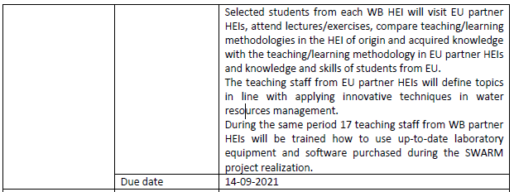
Winter / summer schools
Comments:
NMBU has plans for the summer school 2021. In case of lockdown, it will be online like in 2020
AUTH: considering online
UNIRIFCE: will run it anyway either physical or online
BOKU: online is possible
UACEG: will run it anyway either physical or online
Support from the project:
Evaluation survey for students
Create a list of options of elearning resources / ebooks
Dissemination workshop

Slide 13
How to ensure transparency of selection?
Ideas
Public call
Enrolment test – points weighted by 60% together with marks from the higher school – rating - BEng
Accreditation – number of students
Summer course
Motivation letter + CV
Av. Marks
Used E+ mobilities – broader circle
Language skills – B1

Slide 14
Curricula evaluation survey – end of September
Can we collect program/course/curricula evaluation forms from Program countries and prepare a survey for Partner countries?
BOKU online evaluation
Croatia online on the course level
Greece online
Bulgaria – generic survey using the suggestions from others
Summary document with suggestions
Quality Assurance annexes – Milan
Call for a meeting to discuss with Partner countries

Slide 15
Trainings for professionals

Slide 16
Trainings for professionals
Professional extension courses
Three-day training will be held in WB partner HEIs and conducted by experts from WB partners (one training per WB partner HEI). Foreseen number of trainees 30 per training. Material will be printed and also freely available at SWARM website.
Raise awareness about innovative solutions
Relevant content
Centers for lifelong learning at universities
Who has?
Certification
Self-evaluation of quality
After conducted training, evaluation list will be fulfilled by the trainees and serve as a source for improvement future trainings
Webinars
Project certificates

Slide 17
Content
First day
- EU water policy under the Water Framework Directive (4 hours)
* Objectives and instruments of EU Water Policy
* Integrating water policy: Linking all EU water legislation within a single framework
* Roadmap to implementing the directive’s economic analysis
* Best practice examples for using Water Framework Directive
- Water management and climate change adaptation (4 hours)
* Water and climate change – policy framework
* Climate Change and the European Water Dimension
* Climate change and impacts on water
* Contributing to better water management: Experiences from case studies across Europe
Revise according to handbook

Slide 18
Content
Second day
- Wastewater treatment and reuse of treated wastewater (4 hours)
* Treatment of Urban Waste Water Directive and EU legislation related to water reuse
* Standards for the quality of reused treated wastewater
* Potential sources and uses for reuse of treated wastewater
* Water reuse in Europe - needs for and barriers to innovation
- Flood and drought risk management (4 hours)
* European policies influencing the management of floods
* Flood risk management, climate change adaptation and disaster risk reduction
* Challenge from water scarcity and droughts
* Good practices and learned lessons across Europe in preventing and managing water scarcity, flood and drought situations
Name

Slide 19
Content
Third day
- Innovation in the water sector (6 hours)
* Policies on water and innovation in Europe
* Cyber safety in water infrastructure and services
* What is water innovation
* Barriers and bottlenecks for innovation in the water sector
* Examples of innovation in the water sector
* Promoting public-private partnerships and collaboration with HEIs
Milan requests Brussels

Slide 20
Who is our target audience?
Public
Water supply agencies
Water Protection Agencies
Municipal agencies
Ministry of Agri, Forestry, Special Planning
Planning agency
Environmental Protection Ministry
River basin directorates
Construction companies
Hydro power plants operators
Private
Agriculture companies
NGOs
Consultancy – design
Construction companies
Small hydropower operators
There should be transparency in involvement of companies because of subsidy from EU project

